Slide 1
ELECTRIC MOTOR TEMPERATURE
P189

Slide 2
NAME OF TEAM --> P_189 / TEAM 3
MENTOR --> Ms. PALLAVI
TEAM MEMBERS --> 1. ANUJ KUMAR
2. DATTATRAY BODAKE
3. IRFAN SHAIK
4. SUPRIYA DUSTHAKAR
5. RAHUL GANDHASIRI
6. RAM GOUD
7. AKSHAY BESARLA

Slide 3
Project Flow
Business Objective
Data Set Details
Exploratory Data Analysis
Model Building
Model Evaluation
Deployment

Slide 4
Business Objective:
Prediction of Permanent Magnet Synchronous Motor temperature based on other attributes available. that is, currents, voltages, coolant and ambient temperatures, and torque as well as motor speed. All sensor data is deployed on a test bench.

Slide 5
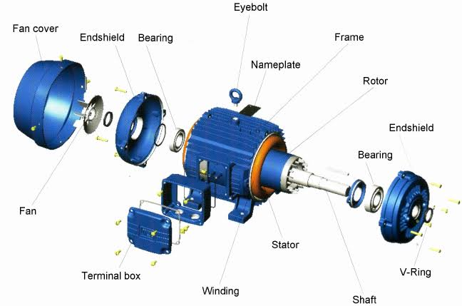
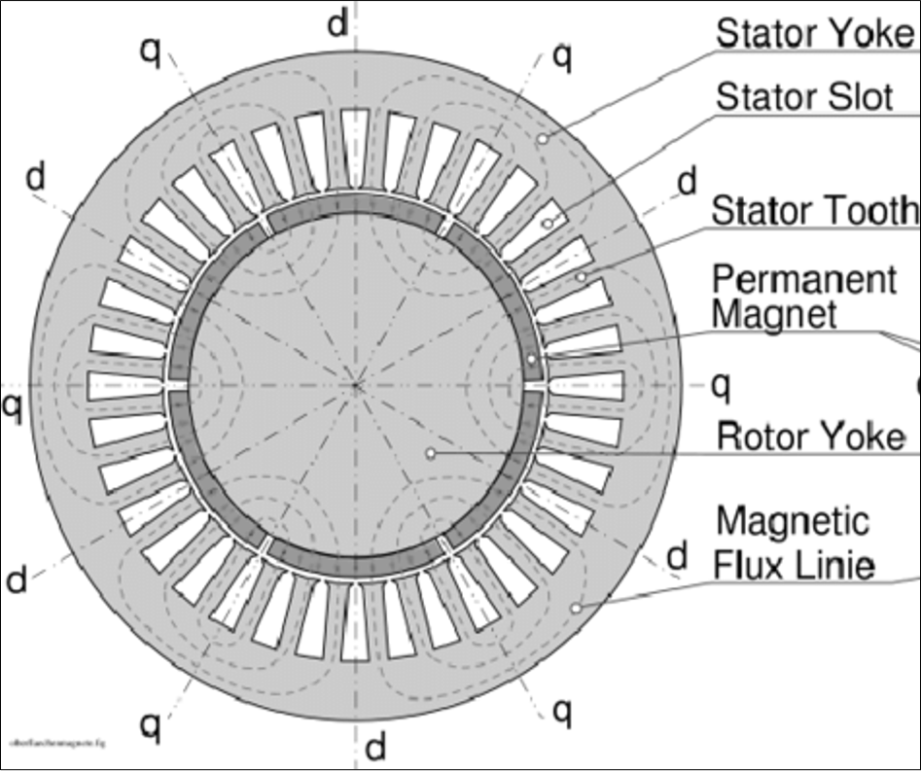
Permanent Magnet Synchronous Motor: :
The working of PMSM depends on the rotating magnetic field of the stator and the constant magnetic field of the rotor.
The permanent magnets are used as the rotor to create constant magnetic flux, operates and locks at synchronous speed.

Slide 6
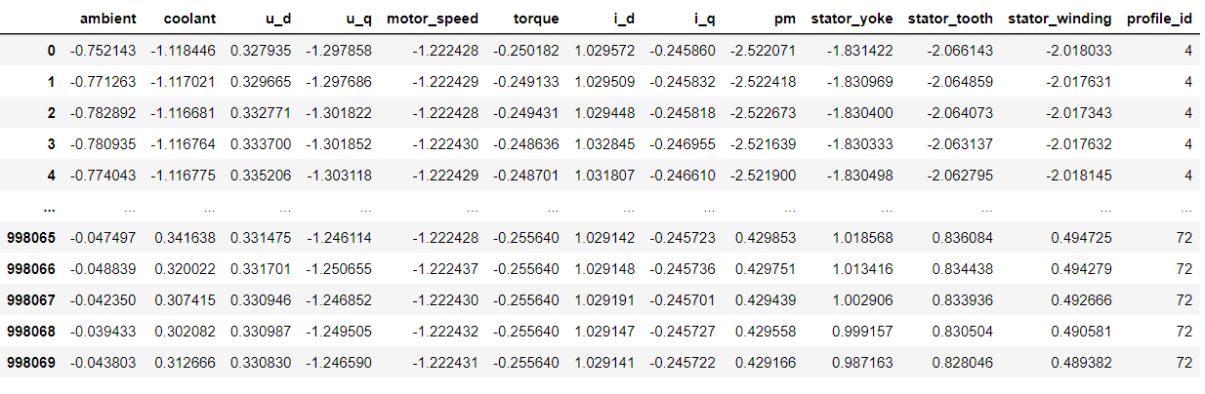
DATASET:
The Dataset comprises several sensor data collected from a permanent magnet synchronous motor (PMSM) deployed on a test bench.
The PMSM represents a ccTest bench measurements were collected by the LEA department at Paderborn University.
All recordings are sampled at 2Hz.
The dataset consists of multiple measurements sessions,which can be distinguished from each other by the column “profile_id”.
The Data contains 998070 rows and 13 columns without removing outliers.

Slide 7

EXPLORATORY DATA ANALYSIS :

Slide 8
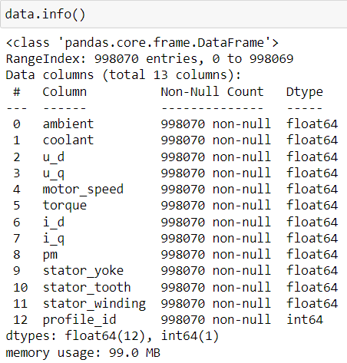
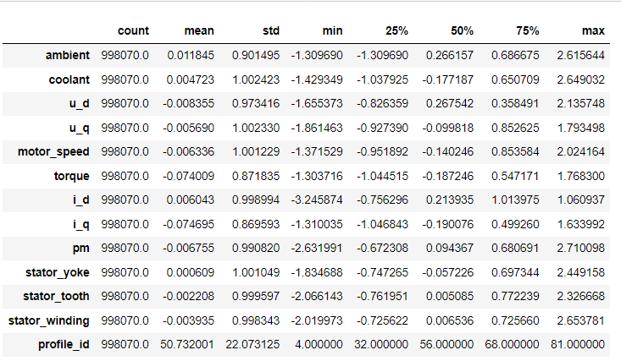
Except profile_id , all other values have the datatype float64 . Profile_id is of int64 datatype.
The dataset contains no Null Values.
Using describe( ) function to generate descriptive statistics. The above image contains Count , Mean , SD, Min, Max values of all the columns.

Slide 9
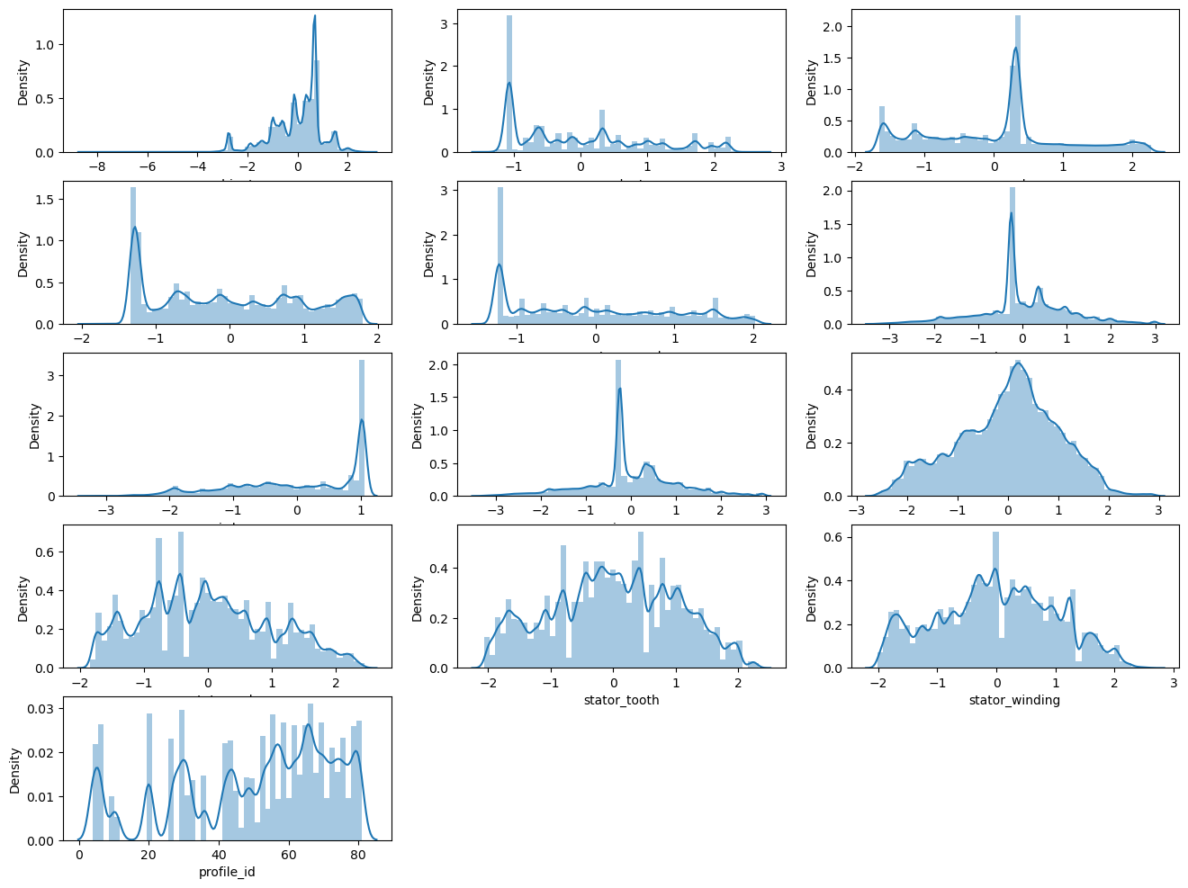
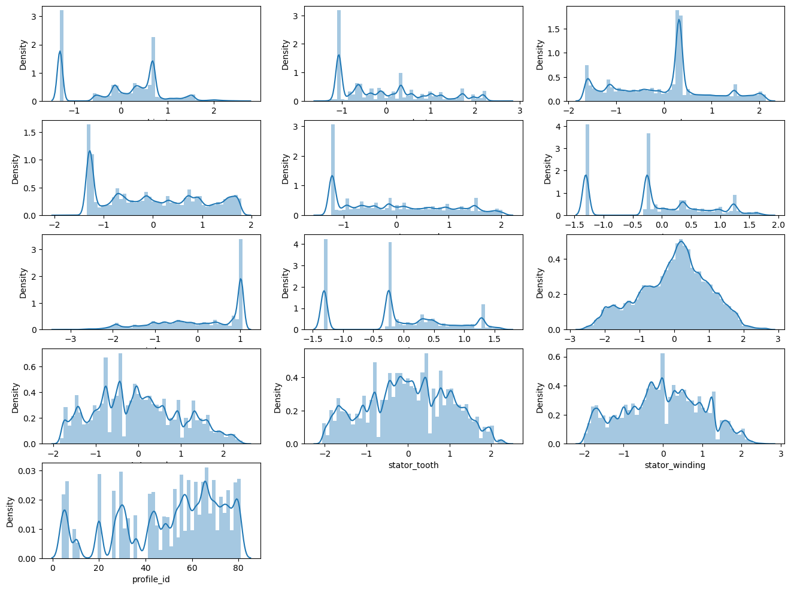
Distribution Plot with Outliers
Distribution Plot without outliers
1.In distribution plot ambient, u_d, torque, i_q and pm plots contains outliers .
2. Remaining not having any outliers .

Slide 10
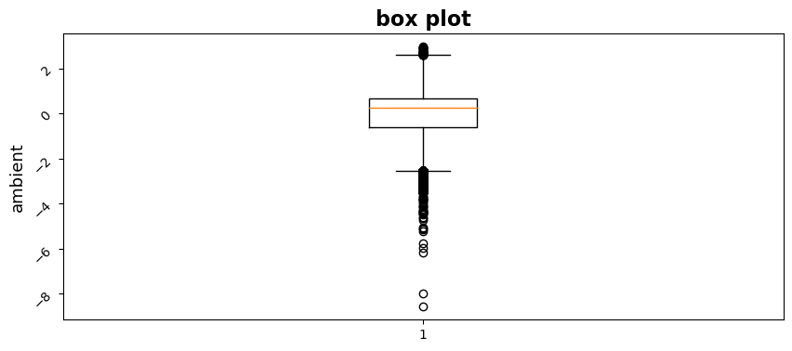
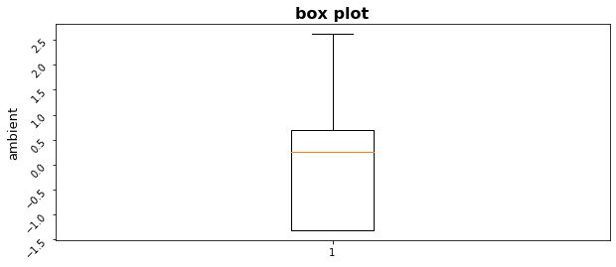
BOXPLOT:
Boxplot with outliers
Boxplot without outliers

Slide 11
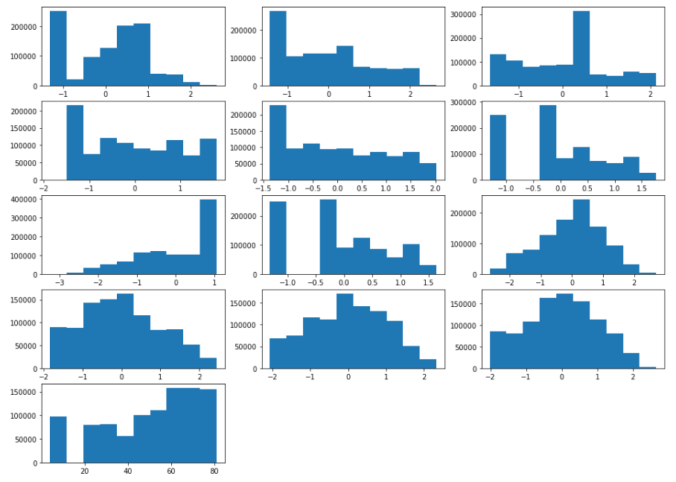
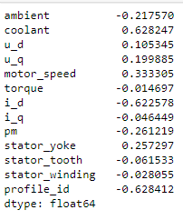
HISTOGRAM
SKEWNESS
Histogram for checking whether my data is normally distributed or not

Slide 12
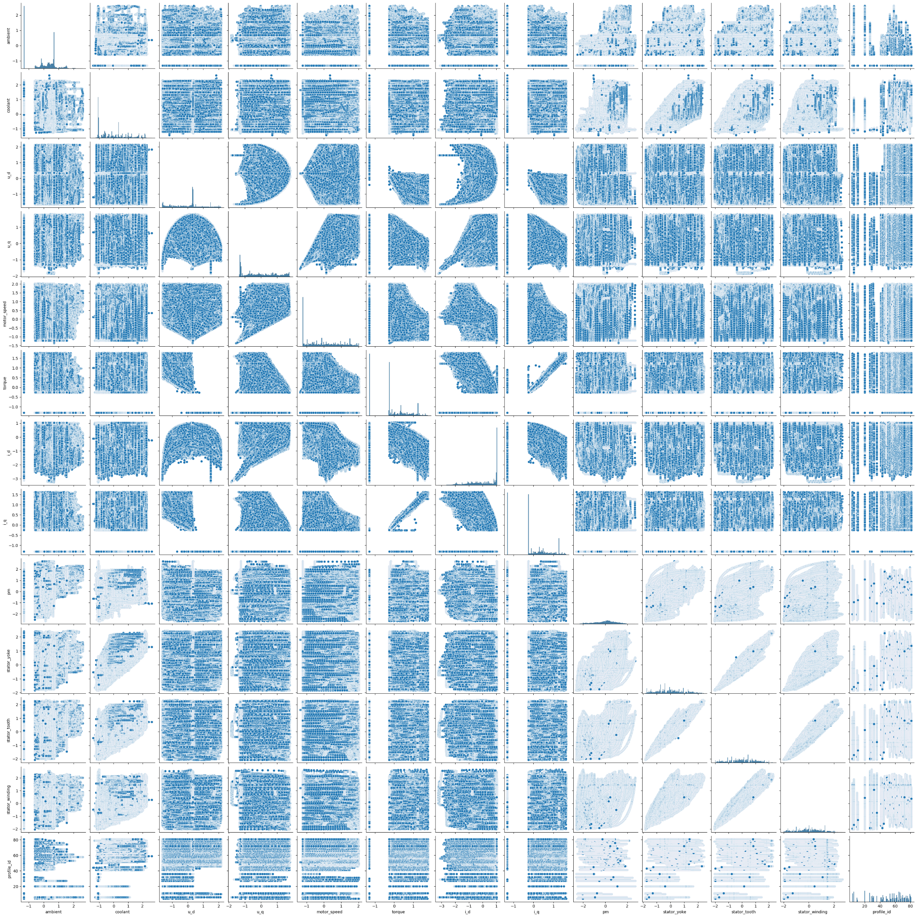
Pairplot:

Slide 13
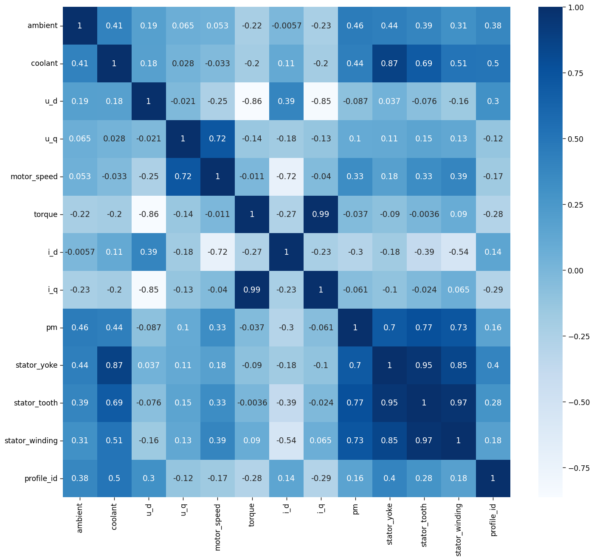
correlation: Heatmap

Slide 14
Model Building

Slide 15
Models:
Multiple Linear Regression
K-Nearest Neighbours
Decision Tree
XGBoost Regressor
Adaboost Regressor
Random Forest

Slide 16
1.Multiple linear Regression:
Training Accuracy is = 93.60%
Testing Accuracy is = 93.57 %
Mean Squared Error = 0.0643
Mean Absolute Error = 0.1923
Root Mean Squared Error = 0.2537
R2 score = 0.9357
Linear Regression is a supervised machine learning algorithm where the predicted output is continuous and has a constant slope. It's used to predict values within a continuous range.
2. K-NEAREST NEIGHBOURS:
Training Accuracy is = 99.86%
Testing Accuracy is = 99.82 %
Mean Squared Error = 0.00175
Mean Absolute Error = 0.01731
Root Mean Squared Error = 0.04187
R2 score = 0.9982
Implementation of KNN regression is to calculate the average of the numerical target of the K nearest neighbors. Another approach uses an inverse distance weighted average of the K nearest neighbors. KNN regression uses the same distance functions as KNN classification

Slide 17
3.DECISION TREE:
Training Accuracy is = 99.99%
Testing Accuracy is = 99.94 %
Mean Squared Error = 0.0005
Mean Absolute Error = 0.00763
Root Mean Squared Error = 0.0223
R2 score = 0.9994
Decision tree builds regression or classification models in the form of a tree structure. It breaks down a dataset into smaller and smaller subsets while at the same time an associated decision tree is incrementally developed. Decision trees can handle both categorical and numerical data
4.XGBOOST REGRESSOR:
Training Accuracy is = 99.94%
Testing Accuracy is = 99.92%
Mean Squared Error = 0.00175
Mean Absolute Error = 0.01731
Root Mean Squared Error = 0.04187
R2 score = 0.9982
XGBoost is an efficient implementation of gradient boosting that can be used for regression predictive modeling.

Slide 18
5.ADABOOST REGRESSOR:
Training Accuracy is = 90.55%
Testing Accuracy is = 90.57%
Mean Squared Error = 0.0945
Mean Absolute Error = 0.2747
Root Mean Squared Error = 0.3070
R2 score = 0.9057
An AdaBoost regressor. An AdaBoost regressor is a meta-estimator that begins by fitting a regressor on the original dataset and then fits additional copies of the regressor on the same dataset but where the weights of instances are adjusted according to the error of the current prediction.
6.RANDOM FOREST:
Training Accuracy is = 99.99%
Testing Accuracy is = 99.97%
Mean Squared Error = 0.00021
Mean Absolute Error = 0.00438
Root Mean Squared Error = 0.0147
R2 score = 0.9997
Random Forest Regression is a supervised learning algorithm that uses ensemble learning method for regression. Ensemble learning method is a technique that combines predictions from multiple machine learning algorithms to make a more accurate prediction than a single model.

Slide 19
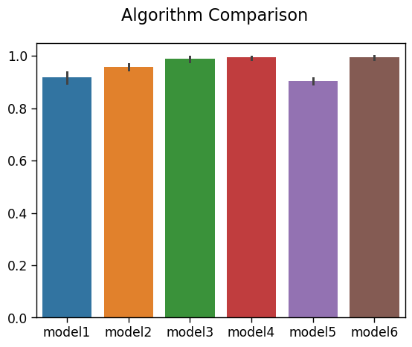
Model vs Testing Accuracy:

Slide 20
DEPLOYMENT

Slide 21
Model Deployment using Random Forest
We have done 6 model for the given dataset.
In those model we have to select model which has high accuracy value and low RMSE value.
Almost every model’s RMSE value is more compared to Random Forest Regressor.
By considering this condition we can use Random forest Regressor.
Which has high Testing accuracy that is value of 99.99% and RMSE value of 0.0147

Slide 22
MODEL DEPLOYMENT:
Before we deploy our model, we need to load our model in our pickle format from where streamlit will run our main python file.
We use the below code to prepare the .pkl file and save it in our path(# Saving the model to disk – (pickle.load(open('model_pickle','rb')Preparing the python file with our parameters(with all our prediction variables)
Saving the .py and .pkl file in our path so that we can run them locally.
We can deploy the model using anaconda prompt > create a virtual environment > create a folder to store our data files> run that folder using streamlit command.

Slide 23
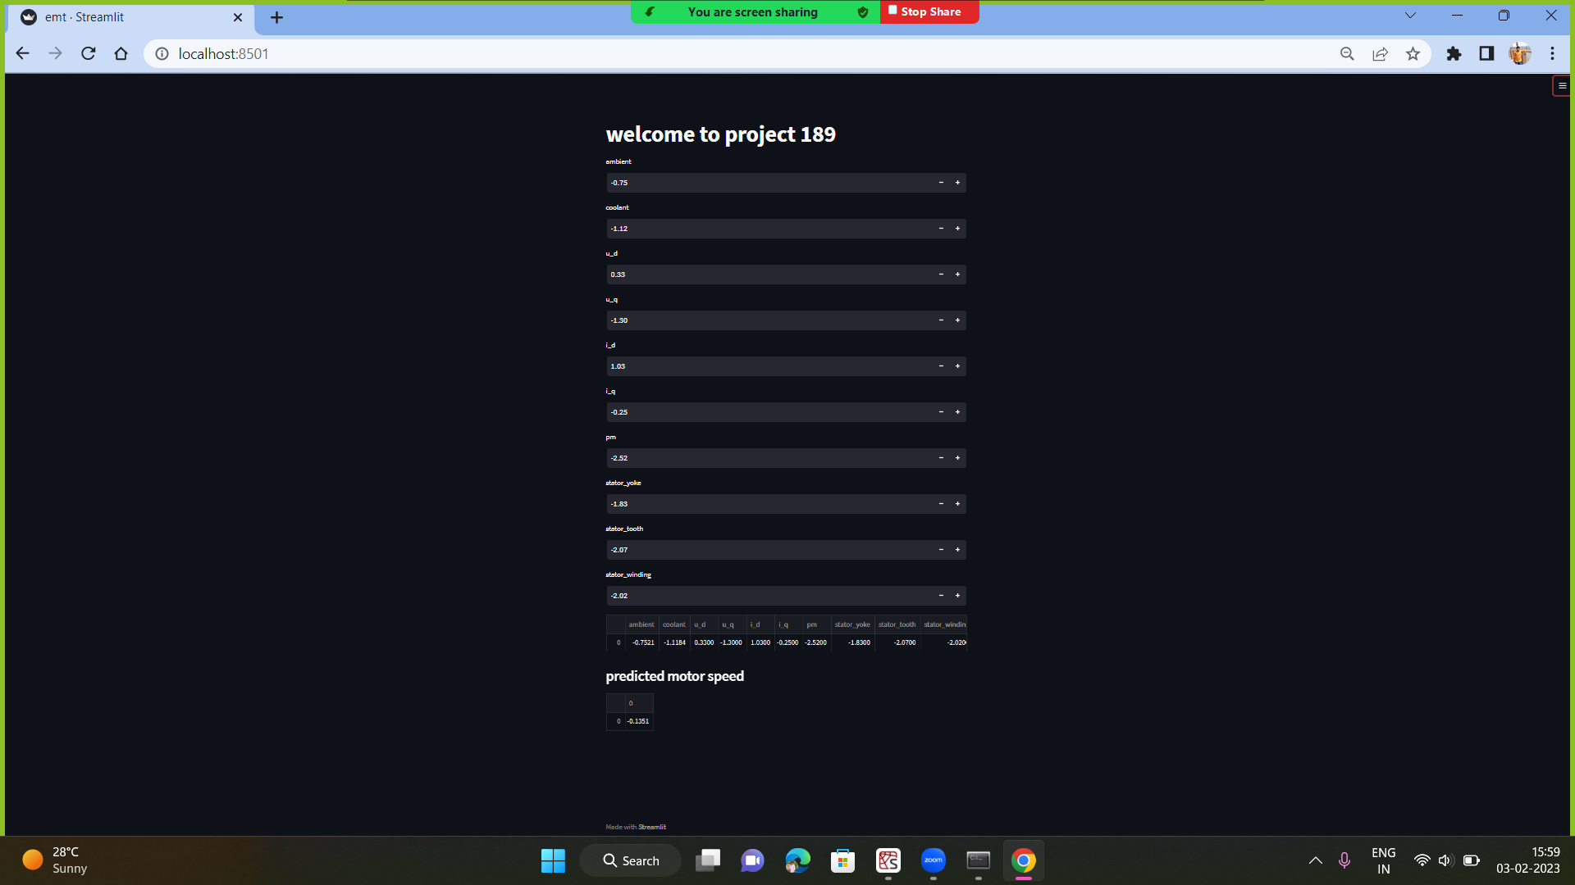
Predicting Motor Speed

Slide 24
Challenges faced?
Data visualisation took more time for plotting data.
The dataset contained with large amount of outliers.
Feature selection doesn’t improve the model evaluation metrics.
Model building was more complicated since, size of data set is very large.
model deployment was complicated
How did you overcome?
Data visualisation was done for unique profile_id instead of whole dataset.
Outliers are treated using caping technique of outlier treatment.
From Feature selection profile_id also part of training dataset.
model deployment was done using streamlit.

Slide 25


